Slide 1
Machine Learning in Azure

Slide 2
Objective
Equip each student with the Azure machine learning tools they can apply immediately
In the words of RW Murphy:
Slightly overwork the student who has average familiarity with the material
While not discouraging students who are brand new to the material
And still challenging the students who are more familiar with the material

Slide 3
Agenda
Day 1
Azure Level set
Setting up your Data Science VM to work as your portal into the Azure Machine Learning service and MLOps for data science
Azure Machine Learning service
Data prep
Model training
Model training on Azure ML service compute
Model operationalization – including deployment and monitoring
Azure Databricks
Workspace setup / cluster setup / Python ADB intro / RDD vs Dataframe vs Dataset
Data prep / Model training
Model operationalization
Homework assignment / recap / Q&A
Day 2
Azure Databricks continued – special guests Terry and Ron from Databricks, live via satellite from the DFC
Cognitive Services
Image classification
Handwriting recognition
Azure ML Studio
A quick introduction on the tool for the citizen data scientist
Model training
Model operationalization
More on the Team Data Science Process and MLOps
Wrap-up next steps

Slide 4
Azure level set

Slide 5
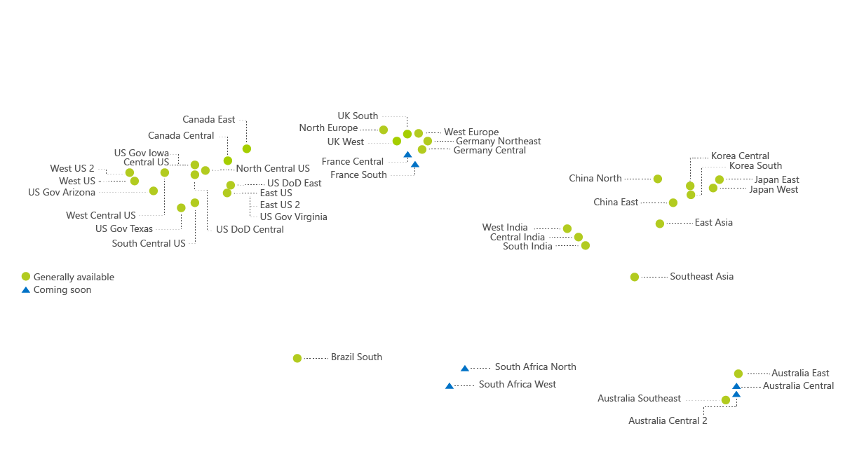
54 Regions

Slide 6

1.6
MILLION MILES OF DARK FIBER

Slide 7












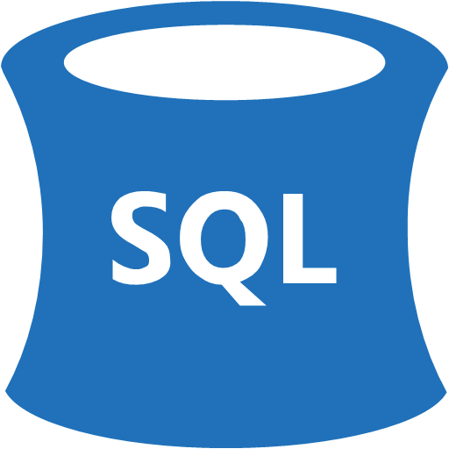









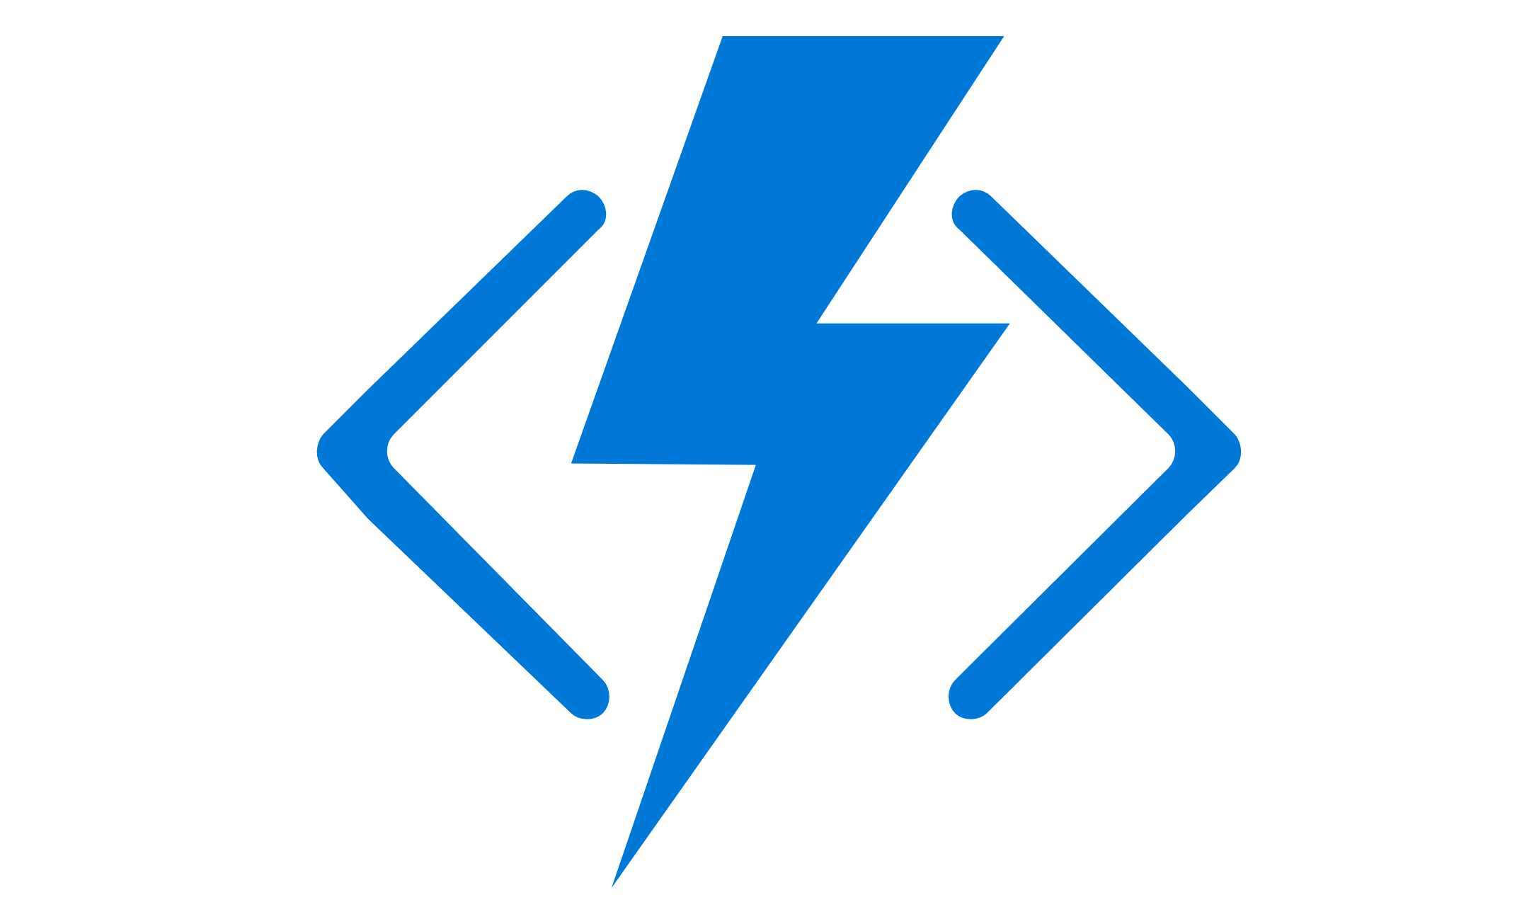
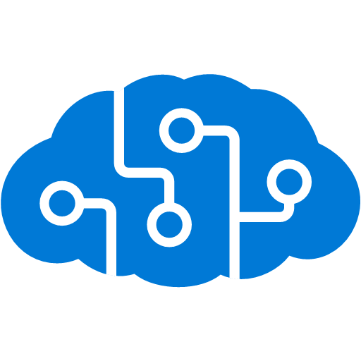










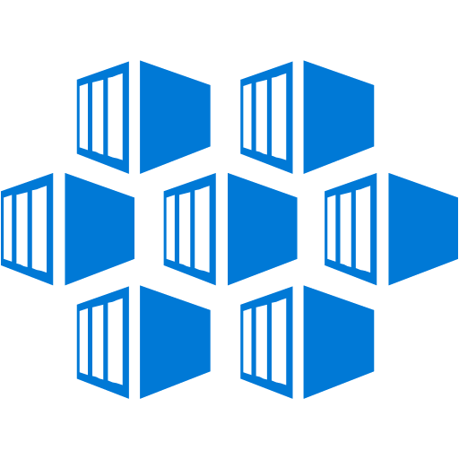

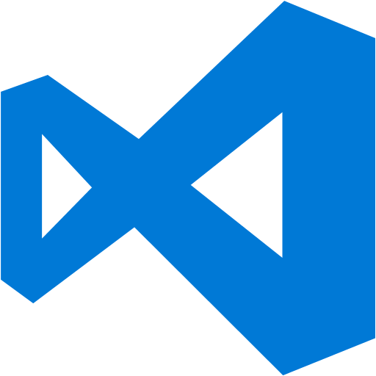



























Platform Services
Security & Management
Hybrid
Cloud
Media & CDN
Application Platform
Data
Security Center
SQL
Database
Azure AD
Health Monitoring
Media Services
Media Analytics
Content Delivery
Network
Web
Apps
Mobile
Apps
SQL Data
Warehouse
CosmosDB
Portal
AD Privileged
Identity
Management
Azure Active
Directory
Integration
SQL Server
Stretch Database
Redis
Cache
Storage
Tables
Azure
Search
API
Apps
Cloud
Services
Azure AD
B2C
API
Management
BizTalk
Services
Domain Services
Service
Fabric
Notification
Hubs
Intelligence
Multi-Factor
Authentication
Logic
Apps
Service Bus
Functions
Cognitive Services
Bot Framework
Cortana
Backup
Automation
Developer Services
Analytics & IoT
Operational
Analytics
Compute Services
Scheduler
HDInsight
Machine
Learning
Stream Analytics
Container
Service
VM
Scale Sets
Visual Studio
Mobile
Engagement
Import/Export
Key Vault
Data
Catalog
Data Lake
Analytics Service
Data Lake Store
Store/
Marketplace
Batch
RemoteApp
VS Team Services
Xamarin
Azure Site
Recovery
Application
Insights
HockeyApp
IoT Hub
Event
Hubs
Data
Factory
Power BI
Embedded
VM Image Gallery
& VM Depot
Dev/Test Lab
StorSimple
Infrastructure Services
Compute
Storage
Networking
Virtual Machines
Containers
Blob
Queues
Files
Disks
Virtual Network
Load Balancer
DNS
Express
Route
Traffic Manager
VPN Gateway
App
Gateway
Datacenter Infrastructure (54 Regions, 52 Online)

Slide 8



































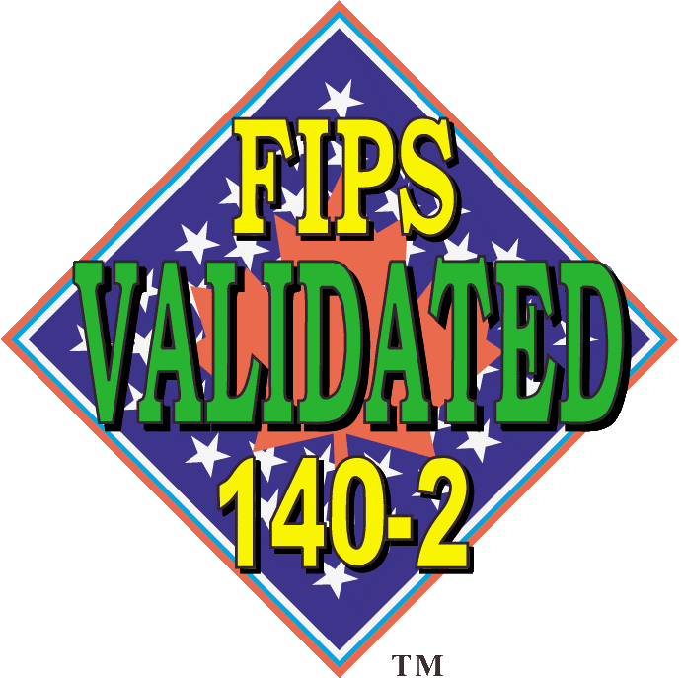




Azure Certifications
Global
ISO 27001
ISO 27018
ISO 27017
ISO 22301
SOC 1 Type 2
SOC 2 Type 2
SOC 3
CSA STAR
Self-Assessment
CSA STAR
Certification
CSA STAR
Attestation
Regional
Argentina PDPA
EU
Model Clauses
UK
G-Cloud
China
DJCP
China
GB 18030
China
TRUCS
Singapore
MTCS
Australia
IRAP/CCSL
New Zealand
GCIO
Japan My
Number Act
ENISA
IAF
Japan CS Mark Gold
Spain
ENS
Spain
DPA
India
MeitY
Canada
Privacy Laws
Privacy
Shield
Germany IT
Grundschutz
workbook
Industry
PCI DSS
Level 1
CDSA
MPAA
FACT UK
Shared
Assessments
FISC Japan
HIPAA/ HITECH Act
HITRUST
GxP
21 CFR Part 11
MARS-E
IG Toolkit UK
FERPA
GLBA
FFIEC
Us Gov
Moderate
JAB P-ATO
High
JAB P-ATO
DoD DISA
SRG Level 2
DoD DISA
SRG Level 4
DoD DISA
SRG Level 5
SP 800-171
FIPS 140-2
Section 508 VPAT
ITAR
CJIS
IRS 1075

Slide 9
Unique Intelligence
Security Technology
Unmatched security
$1B+ annual investments
Over 3500 security experts
Trillions of diverse signals
Secure Foundation

Slide 10











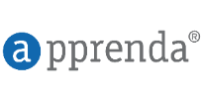













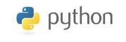


Azure’s open source support
Management
Databases & middleware
Applications
Infrastructure
Linux
App frameworks

Slide 11
Why machine learning in Azure?
Unlimited scale
Compute (CPU, GPU, FPGA), storage, event ingestion
Put close to customers, users, equipment (Azure or Edge)
A record of every run of every experiment
Easy collaboration with teammates, partners, suppliers, customers
Repeatability of model creation & behavior
Evaluation of model predictions
Managing different model versions and files
Operationalization of the model
Monitoring of training and scoring pipelines

Slide 12
IoT PoC Architecture
Our original discussion. Delivering data to the Legacy IaaS Network (also called the Critical Data Zone) could be problematic with the requirements / firewalls involved in that zone.

Slide 13
IoT PoC Architecture
An alternative, where IoT Hub can be installed on-prem.

Slide 14
IoT PoC Architecture
alternative
This alternative also requires sending data across the Legacy IaaS Network / Critical Data Zone barrier. Further, the KafkaConnect would have to be configured / altered to attach to the Kerberized Kafka service

Slide 15
IoT PoC Architecture
alternative
This alternative does not require sending data across the Legacy IaaS Network / Critical Data Zone barrier. The Cloudera cluster would have to be given access to the Blob storage location where the IoT Hub lands the data. The storage account could also be attached to the Cloudera Network, via a Service Endpoint. The IoT data would follow the data ingress pattern currently used for other data in the Cloudera Cluster.

Slide 16
IoT PoC Architecture
alternative
This alternative builds on the previous one, just calling out various other PaaS services available to be able to shape, analyze, report over and reason over the data.

Slide 17
Best practices
Shut off your DSVM from the portal any time you’re not using it
Set up an auto-shutdown rule for the DSVM just in case
For the cautious: before shutting down DSVM
Save all notebooks
Go to the running notebooks tab and shut down any running notebooks
Click into the command window that runs the notebooks and control-c
Be sure your AZ ML compute have min cpu = 0 (auto shutoff)
Be sure your Azure Databricks clusters have an auto shutdown time and use autoscale 1 worker min – n workers max
This deck and other materials are available at:
http://github.com/delbert/azml

Slide 18
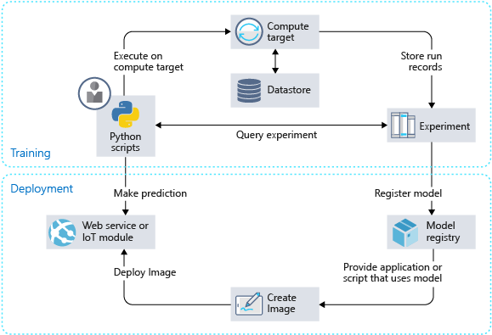
How the Azure ML service works
Develop machine learning training scripts in Python.
Create and configure a compute target.
Submit the scripts to the configured compute target to run in that environment. During training, the scripts can read from or write to datastore. And the records of execution are saved as runs in the workspace and grouped under experiments.
Query the experiment for logged metrics from the current and past runs. If the metrics don't indicate a desired outcome, loop back to step 1 and iterate on your scripts.
After a satisfactory run is found, register the persisted model in the model registry.
Develop a scoring script.
Create an image and register it in the image registry.
Deploy the image as a web service in Azure.
https://docs.microsoft.com/en-us/azure/machine-learning/service/concept-azure-machine-learning-architecture

Slide 19
Setting up Azure Machine Learning service
Create AzureML workspace in Azure portal
Create Resource Group: initials + Mlws
Create Workspace: initials + Workspace
Create DSVM (let’s all do Windows 2016)
Resource Group: initials + DSVM
VM: initials + DSVM
After VM is created, create a DNS name: initials + DSVM

Slide 20
Setting up Azure ML - DSVM / Linux
In JupyterHub (https://dsvm.ip:8000) / terminal
cd notebooks
git clone https://github.com/Azure/MachineLearningNotebooks.git
cd ...
/data/anaconda/bin/conda create -y -n aml Python=3.6
source /data/anaconda/bin/activate aml
pip install azureml-sdk[automl] ipykernel
/data/anaconda/bin/conda install -y cython matplotlib pandas
pip install azureml-widgets
python -m ipykernel install --user --name aml --display-name aml
switch JupyterHub kernel to aml

Slide 21
Setting up Azure ML - DSVM / Windows 2016
In CMD prompt
cd notebooks
git clone https://github.com/Azure/MachineLearningNotebooks.git
cd ..
conda create -y -n aml Python=3.6
conda activate aml
conda install -y cython matplotlib pandas
pip install azureml-sdk[automl] ipykernel
pip install azureml-widgets
python -m ipykernel install --user --name aml --display-name aml
start JupyterLab notebooks
switch JupyterLab kernel to aml when prompted

Slide 22
Azure ML exercises
Configure
Open configure.ipnb - set kernel to aml (+ quick intro to notebooks)
Check version number, cell [1]
Set parameters from AzureML workspace, cell [2]
Save config file, cell [3]
Data Prep
Open tutorials/regression-part1-data-prep.ipnb - set kernel to aml
For each cell
Read over the description and code
Execute the cell
Check out: transforming dates by example
Check out: each transformation is saved as a step in a transformation pipeline
Model Training - AutoML
Open tutorials/regression-part2-automatedml.ipnb - set kernel to aml
For each cell
Read over the description and code
Execute the cell
Walk through Azure portal Azure ML service Workspace
Check out: Experiments, the AutoML run, etc
Check out the next slide, on how AutoML works

Slide 23
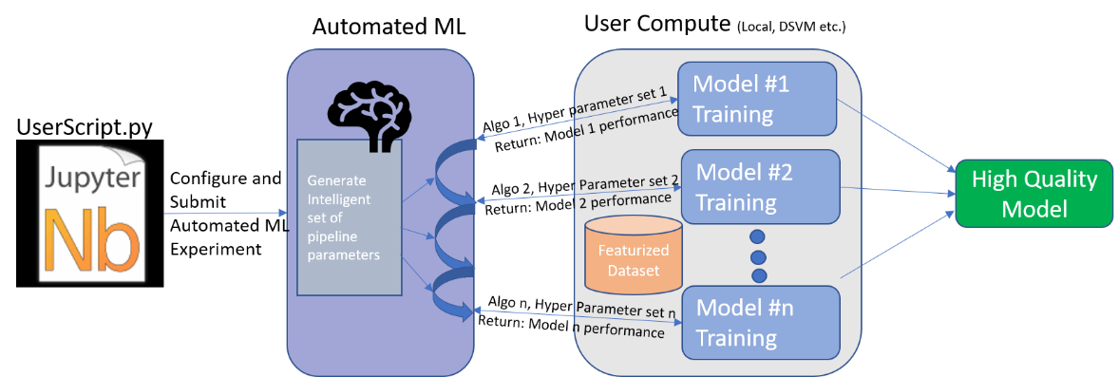
How AutoML works

Slide 24
Fixes
Fix for plot in regression-2:
fig = plt.figure(figsize=(10, 7))

Slide 25
Azure ML challenges
Can you cancel an experiment?
Can you splunk through the various elements in the Workspace, by iterating through them?
Can you add an extra feature to the Taxi dataset called crow_flies_distance and calculate it from lat/long?
Can you use the Python dprep toolkit to automatically one-hot encode a categorical variable?
https://docs.microsoft.com/en-us/azure/machine-learning/service/how-to-transform-data

Slide 26
Azure ML exercises
Model Training with Azure ML Compute
Open tutorials/img-classification-part1-training - set kernel to aml
For each cell
Read over the description and code
Execute the cell
Check out Workspace / storage account for uploaded data
Check out Workspace / Experiments for run info, uploaded model, logs
Model Deployment with Azure Container Instances
Open tutorials/img-classification-part2-deploy - set kernel to aml
Skip the first cell
For each cell
Read over the description and code
Execute the cell
Check out Workspace / Images to see the deployed model -> docker image
Check out Workspace / Deployments to see the deployed model running
Be sure to execute last cell, to delete ACI deployment
Double-check Workspace / Deployments to be sure deployed model is shut down

Slide 27
Azure ML challenges
Are you familiar with the Template Method design pattern? How is it used when you train your model with Azure ML Compute?
What do you do if you want to create a deep neural network with PyTorch or TensorFlow and train it on a TB of data?
Can you add monitoring via App Insights to the deployed model?
https://docs.microsoft.com/en-us/azure/machine-learning/service/how-to-enable-app-insights
Can you collect data on how well your model is performing?
https://docs.microsoft.com/en-us/azure/machine-learning/service/how-to-enable-data-collection

Slide 28
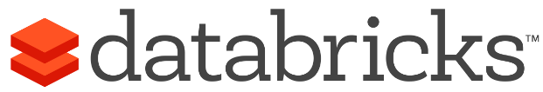
Azure Databricks
Azure Databricks is a first party service on Azure.
Unlike with other clouds, it is not an Azure Marketplace or a 3rd party hosted service.
Azure Databricks is integrated seamlessly with Azure services:
Azure Portal: Service an be launched directly from Azure Portal
Azure Storage Services: Directly access data in Azure Blob Storage and Azure Data Lake Store
Azure Active Directory: For user authentication, eliminating the need to maintain two separate sets of uses in Databricks and Azure.
Azure SQL DW and Azure Cosmos DB: Enables you to combine structured and unstructured data for analytics
Apache Kafka for HDInsight: Enables you to use Kafka as a streaming data source or sink
Azure Billing: You get a single bill from Azure
Azure Power BI: For rich data visualization
Eliminates need to create a separate account with Databricks.
Microsoft Azure

Slide 29



Azure Databricks
Azure Databricks
Collaborative Workspace
IoT / streaming data
Machine learning models
DATA ENGINEER
DATA SCIENTIST
BUSINESS ANALYST
Deploy Production Jobs & Workflows
Cloud storage
BI tools
MULTI-STAGE PIPELINES
JOB SCHEDULER
NOTIFICATION & LOGS
Data warehouses
Optimized Databricks Runtime Engine
Data exports
Hadoop storage
DATABRICKS I/O
APACHE SPARK
SERVERLESS
Rest APIs
Data warehouses
Enhance Productivity
Build on secure & trusted cloud
Scale without limits
Notes:
Databricks, founded by the team that created Apache Spark – unified analytics platform that accelerates innovation by unifying data science, engineering & business.
75% of the code committed to Apache Spark comes from Databricks
Unified Runtime
Create clusters in seconds, dynamically scale them up and down.
They’ve made enhancements to Spark engine to make it 10x faster than open source Spark
Serverless- Auto-configured multi-user cluster, Reliable sharing with fault isolation
Unified Collaboration
Overall – a simple & collaborative environment that enables your entire team to use Spark & interact with your data simultaneously
DE – Improve ETL performance, zero management clusters. Execute production code from within notebooks
DS - For data scientists, easy data exploration in notebooks
Business SME – interactive dashboards empower teams to create dynamic reports
Enterprise Security
Encryption
Fine grained Role-based access control (files, clusters, code, application, dashboard)
Compliance
Rest APIs
DE – DBIO, SPARK, API’s , JOBS
DS – Spark and Serverless, Interactive Data Science
Data Products - Everything
Creators of Spark
Training People
Number of Customers
Ingest
Workflow
Schedule / Run / Monitor
Execute
Troubleshoot
Debug
Production Jobs
---------
Ingest, ETL, Scheduling, Monitoring

Slide 30
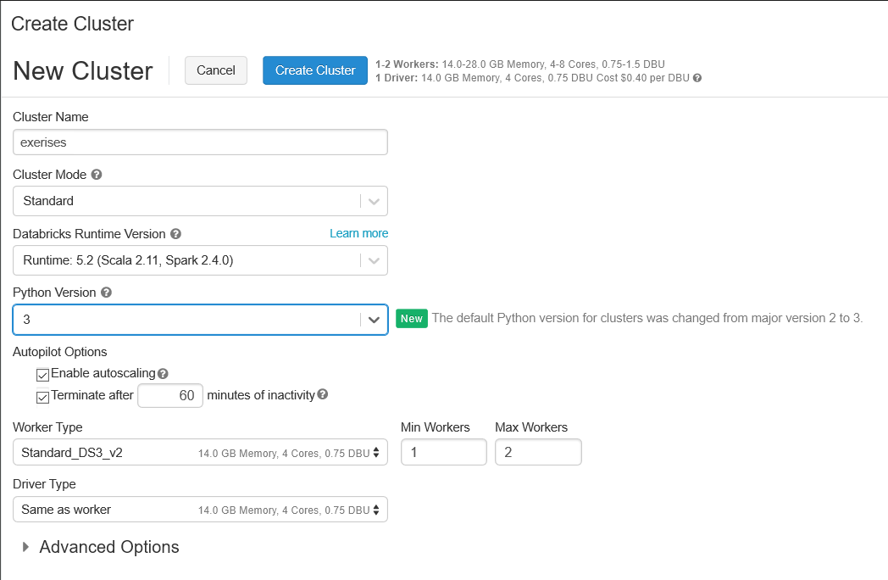
Setting up Azure Databricks
Create Azure Databricks workspace in Azure portal
Launch your workspace
Import notebooks
Home>userid>import>URL>
https://docs.azuredatabricks.net/_static/notebooks/getting-started/quickstartusingpython.html
https://docs.databricks.com/_static/notebooks/getting-started/popvspricelr.html
https://github.com/delbert/azml/blob/master/ip21.dbc
https://docs.azuredatabricks.net/_static/notebooks/mleap-model-export-demo-python.html
Create a Databricks cluster
Clusters>+Create Cluster>

Slide 31
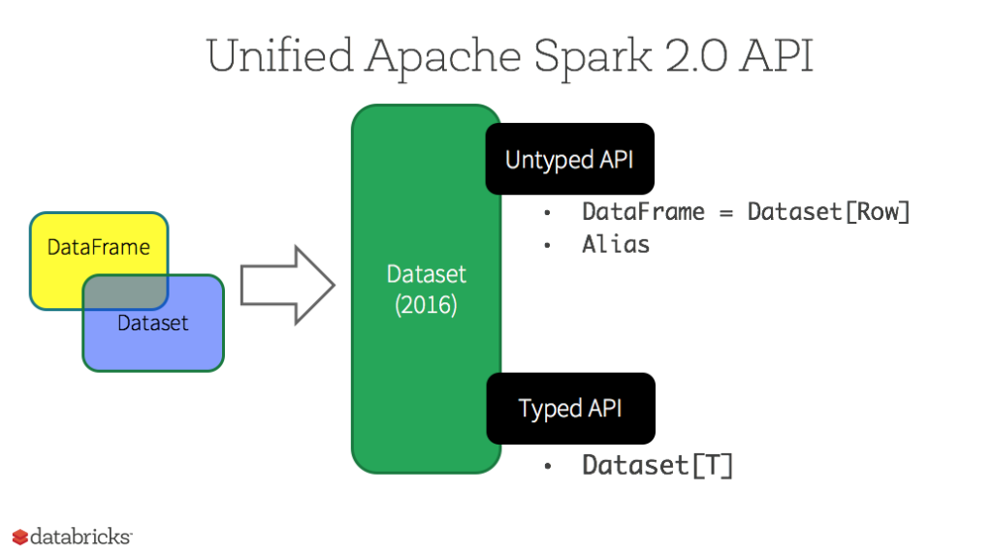
Azure Databricks exercises
Getting started
Workspace>userid>Quick Start Using Python
For each cell
Read over the description and code
Execute the cell
In Python and R, we work with DataFrames
Difference between RDDs, DataFrames, and Datasets
Resilient
Distributed
Dataset
All of these are immutable, but this
changes with Delta.

Slide 32
Azure Databricks exercises
Doing regression on home prices, based on population
Workspace>userid>Pop vs. Price LR
For each cell
Read over the description and code
Execute the cell
Work with IP21 data and Spark SQL
Workspace>userid>ip21
For each cell
Read over the description and code
Execute the cell
Notice the magic: %sql to invoke Spark SQL
Notice creating an external table first, then once column conversions are set, create table as select (CTAS)
Finally, notice the different charting/graphing options for formatting output cells

Slide 33
Azure Databricks exercises
Operationalize Model
Workspace>userid>MLeap Model Export Demo (Python)
For each cell
Read over the description and code
Execute the cell

Slide 34
Azure Databricks challenges
Do you have a use case for Cosmos DB + ADB?
(hint: large-scale data injestion, perhaps from Power Inverters?)
(hint2: see next slide)
Check out MMLSpark – can you create an MMLSpark cluster and try out the sample notebook?
http://aka.ms/spark
https://github.com/Azure/mmlspark/
If you need to create a deep neural network and train it on PyTorch or TensorFlow in ADB, how would you do it?

Slide 35
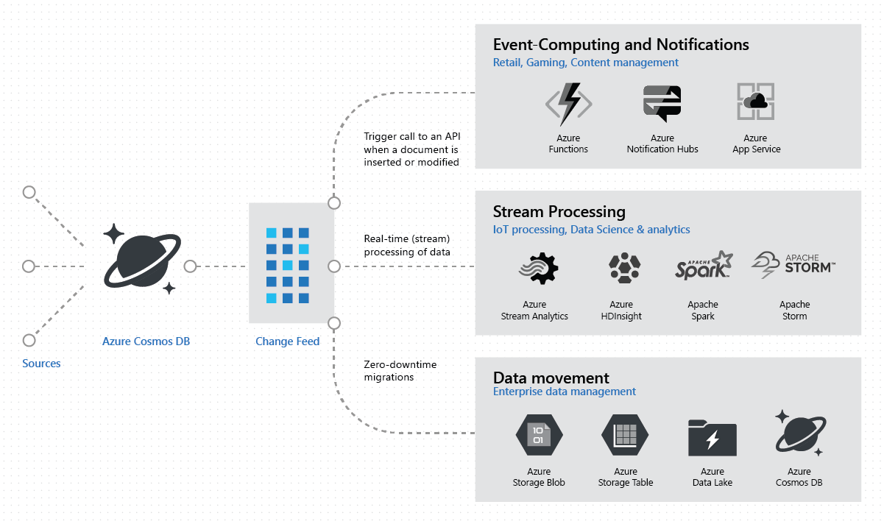
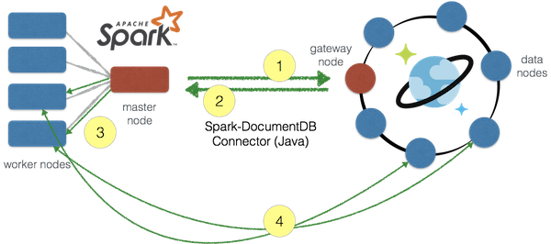
Other Azure Databricks topics
Azure Cosmos DB connector for Spark
https://github.com/Azure/azure-cosmosdb-spark#using-databricks-notebooks
Includes flight predictions example and a change feed example, among others

Slide 36
Cognitive Services / Knowledge Mining

Slide 37





Cognitive Services capabilities Infuse your apps, websites, bots, and machine learning pipelines with human-like intelligence
Vision
Speech
Language
Knowledge
Search
Object, scene, and activity detection
Face recognition and identification
Celebrity and landmark recognition
Emotion recognition
Text and handwriting recognition (OCR)
Video metadata, audio, and keyframe extraction and analysis
Explicit or offensive content moderation
Custom image recognition
Speech transcription (Speech-to-text)
Speech Synthesis (Text-to-speech)
Real-time speech translation
Speaker identification and verification
Custom Speech models for transcription and translation
Custom voice
Language detection
Text sentiment analysis
Key phrase extraction
Entity recognition
Spell checking
Explicit or offensive text content moderation, PII detection
Text translation
Customizable text translation
Contextual language understanding
Q&A extraction from unstructured text
Knowledge base creation from collections of Q&As
Semantic matching for knowledge bases
Customizable content personalization learning
Ad-free web, news, image, and video search results
Trends for video, news
Image identification, classification and knowledge extraction
Identification of similar images and products
Named entity recognition and classification
Knowledge acquisition for named entities
Search query autosuggest
Ad-free custom search engine creation

Slide 38
Knowledge Mining
INGEST
STORE
PREP & TRAIN
MODEL & SERVE
Media (unstructured)
Natural Language Processing Image Processing Custom Models
Web &
mobile apps
Files (unstructured)
Azure Data Factory
Azure Data Lake Storage
Cosmos DB
Azure App Service

Slide 39
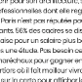


Knowledge mining with Azure Search
Documents
Cutting-edge AI
Fully text-searchable rich index
Key Phrase extraction
Location entity extraction
Sentiment analysis
Organization entity extraction
Persons entity extraction
Language detection
Face detection
Celebrity recognition
Tag extraction
Custom skills
Landmark detection
Printed text recognition

Slide 40
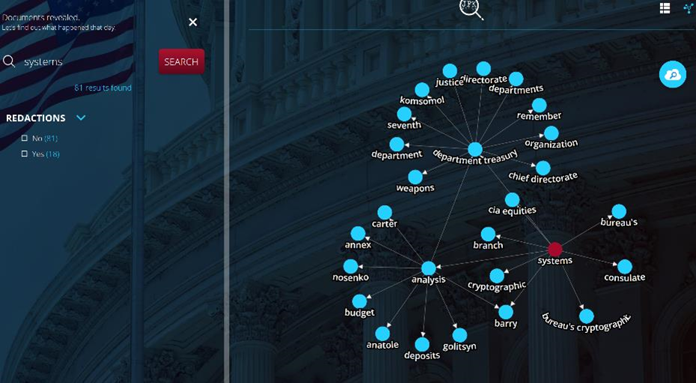
Knowledge mining Demo
JFK Files
https://jfk-demo.azurewebsites.net/

Slide 41
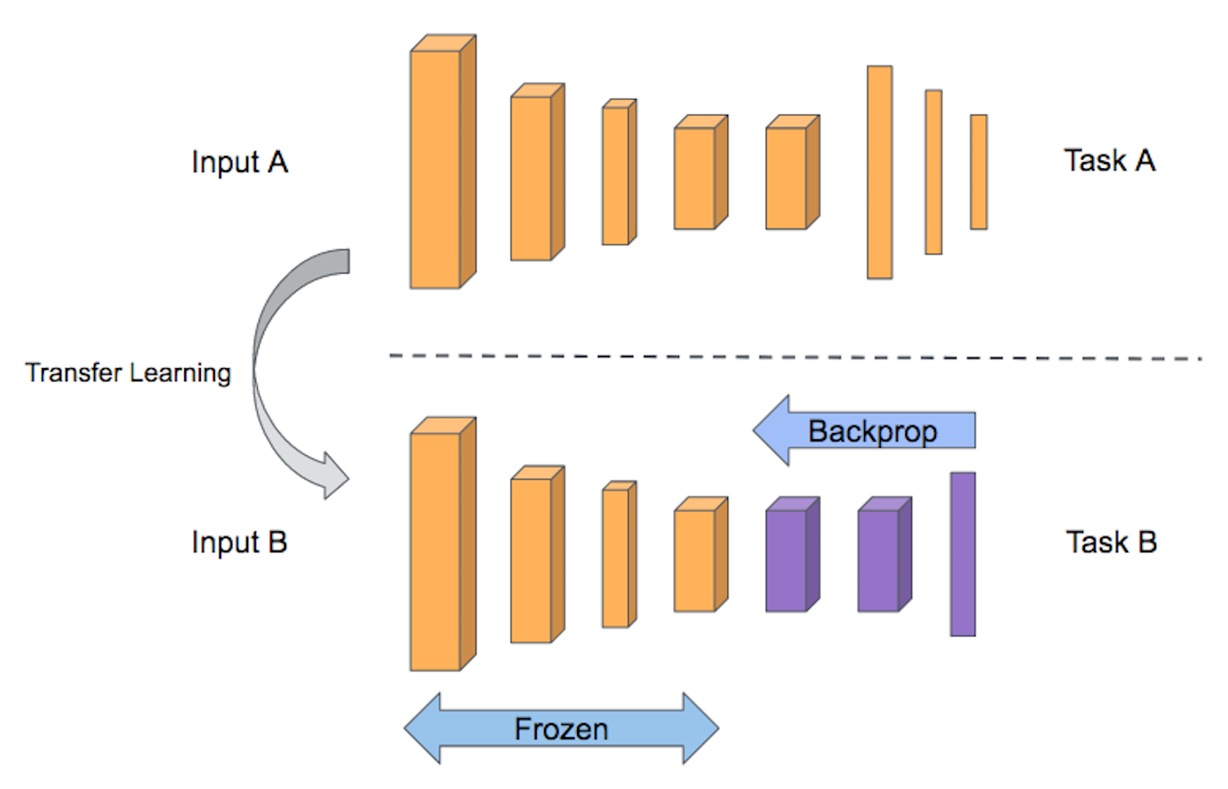
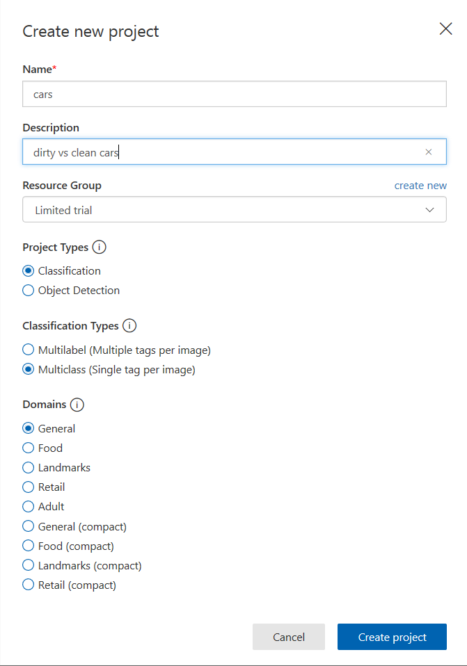
Cognitive Services API exercises
Image recognition
Go to: https://www.customvision.ai/
Sign in
Choose an image classification task
Create new project
Upload/tag images (5 images / tag)
Keep one extra image of each class to test
Train
Predictions / Quick Test
Transfer learning for DNNs:

Slide 42
Cognitive Services API exercises
Read handwritten text from images
Write a message on a piece of paper or the white board
Go to: https://azure.microsoft.com/en-us/services/cognitive-services/computer-vision/
Scroll down to Preview: Read handwritten text from images
Submit your picture

Slide 43
Cognitive Services challenges
Can I run a Custom Vision service model on my phone?
When would I not use Custom Vision? If I can’t use Custom Vision, what can I use in Azure, instead?
Can you set up a call to one of the Cognitive Service ReST API from your iPython notebook?

Slide 44
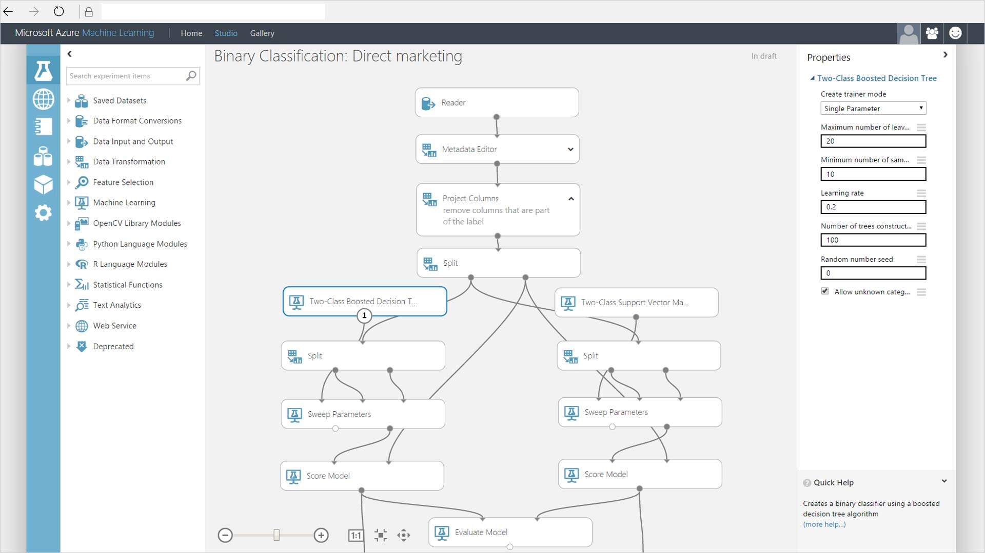
azure machine learning studio for the citizen data scientist

Slide 45
Azure Machine Learning Studio Exercises
Build a binary classification model
Portal>new>Azure Machine Learning Studio Workspace>create workspace
Inside of workspace>Launch Machine Learning Studio>sign in
Tour left side
Experiment>new>blank experiment
Tour left side
We’ll do this one together
Saved Datasets>Samples>Adult Census Income Binary Classification
Right-click>Dataset>Visualize
Search>split>Split Data
Search>boosted>Two-Class Boosted Decision Tree Model
Search>train>Train Model
Search>score>Score Model
Search>evaluate>Evaluate Model
Save/Run
Setup Web Service>Predictive Service
Run
Deploy Web Service Classic>Test Request/Response
50, Private, 200000, Bachelors, 16, Married-civ-spouse, Prof-specialty, Husband, White, Male, 0, 0, 40 United States
Result: … , ">50K","0.634786188602448"

Slide 46
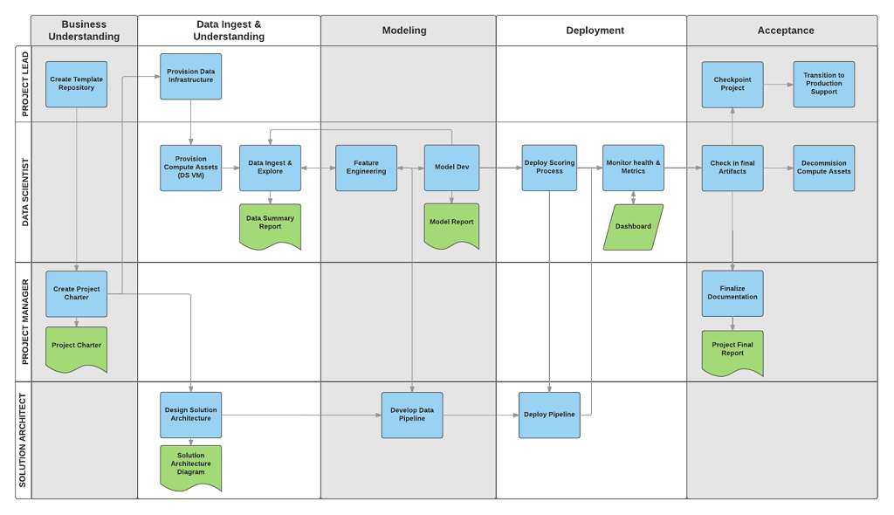

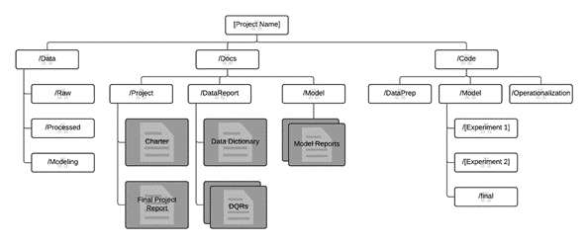
Data science is a team sport
Microsoft Team Data Science Process
http://aka.ms/tdsp

Slide 47
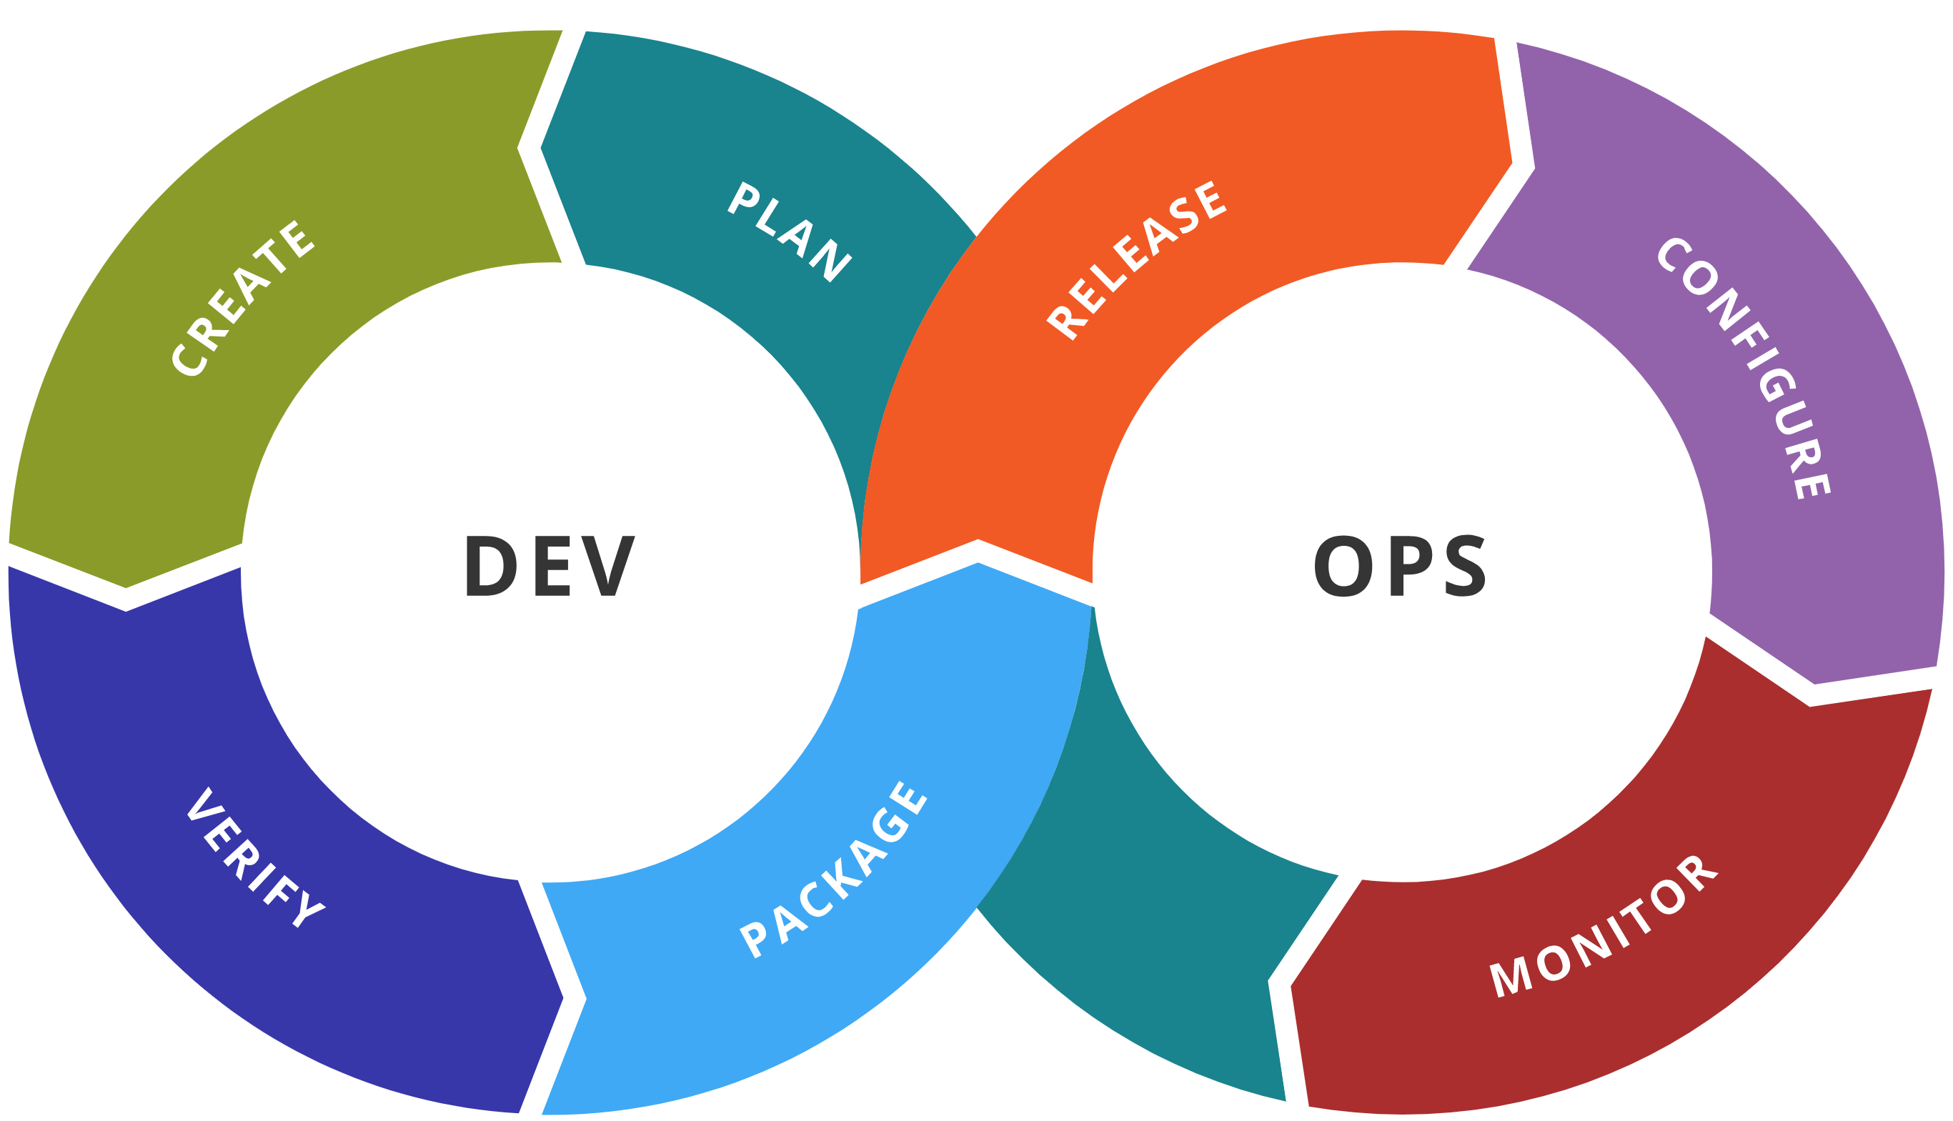
AI DevOps lifecycle
Experiment
Experiment
Data Acquisition
Business Understanding
Initial Modeling
Develop
Modeling
Operate
Continuous Delivery
Data Feedback Loop
System + Model Monitoring
+ Testing
Continuous Integration
Continuous Deployment

Slide 48
Key Goals of DevOps for AI
Repeatability of model creation & behavior
Evaluation of model predictions
Managing different model versions and files
Operationalization of the model
Monitoring of training and scoring pipelines

Slide 49




DevOps Framework for Azure AI Solutions
Plan and track
Code
Build and test
Deploy
Operate
Monitor
Boards
(Azure DevOps)
Repos
(Azure DevOps / GitHub)
Pipelines & Test Plans
(Azure DevOps)
Artifacts & Pipelines
(Azure DevOps)
Model monitoring
(Azure Machine
Learning Service)
Application
Insights
Training Pipelines (Azure ML)

Slide 50
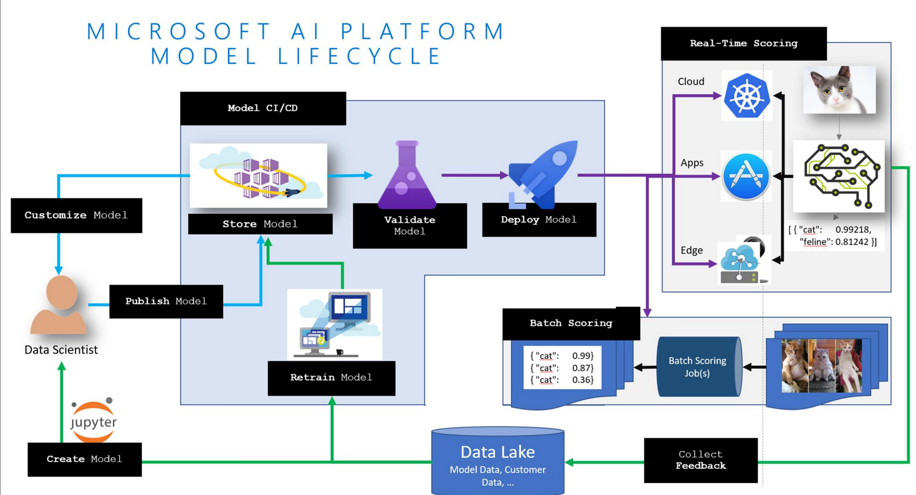
MLOps: Model Lifecycle

Slide 51




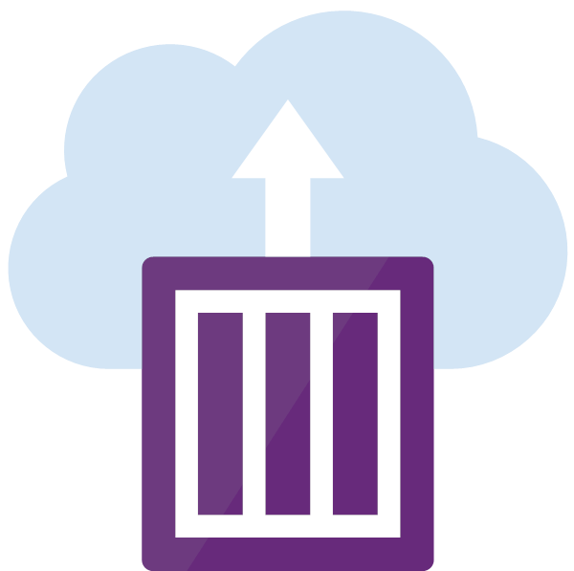

Integrated Pipeline for Data Scientists and Software Engineers
Data scientist
Experimentation Service – Train Model
Version
changes
Deploy (Test)
Code unit test
Data test
Train Model
Model sanity test
Model offline evaluation test
Deploy (Prod)
Version
changes
Integration test
Build pipeline
Software engineer

Slide 52



Q&A / Next steps
© Bill Watterson

